Slide 1

ENR App UX Redesign
Made by: Maryam Gomaa Dabash

Slide 2

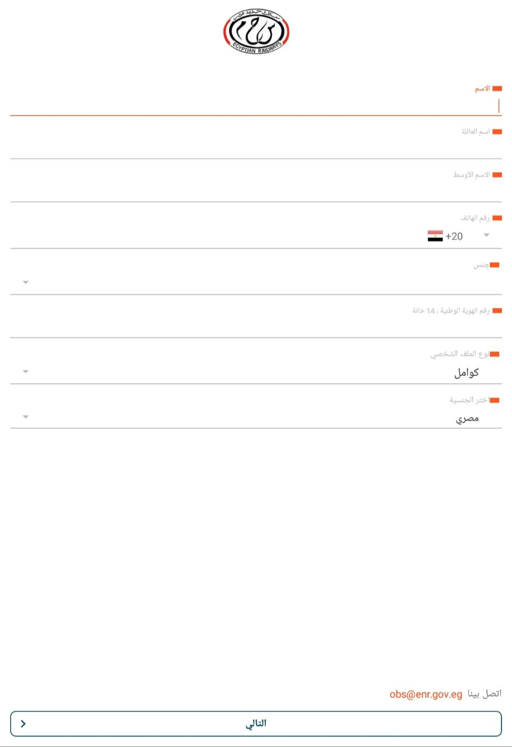
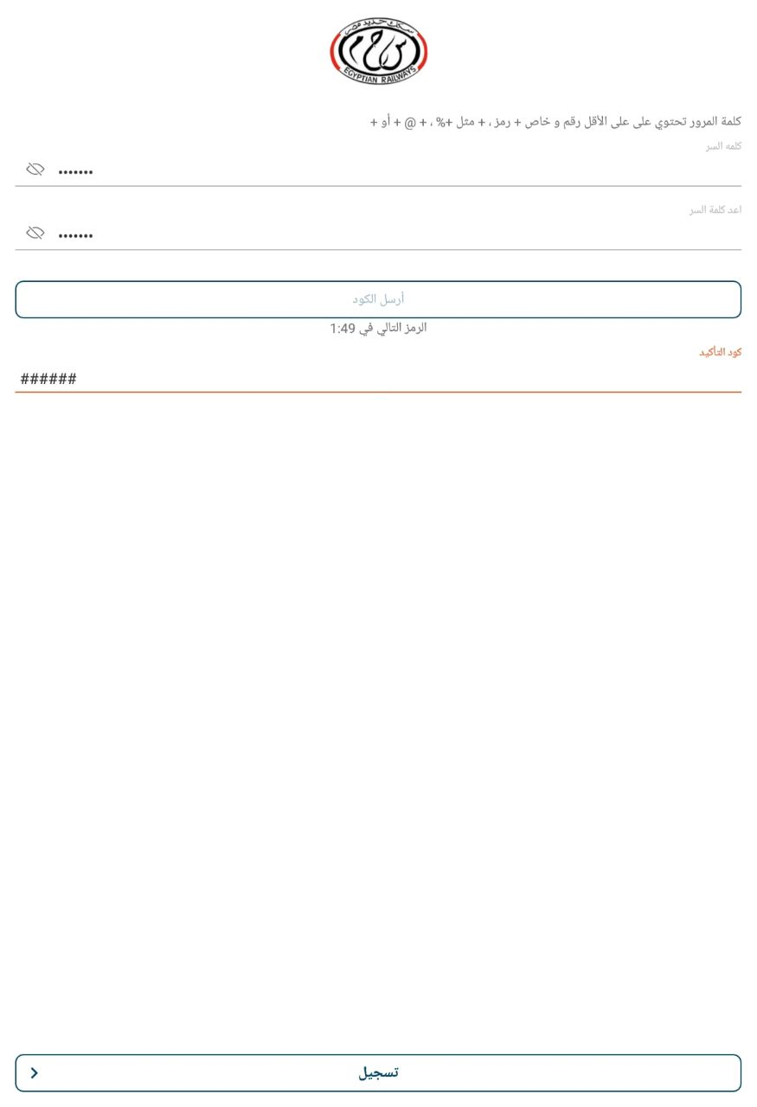
Login & Verification Issues:
The purpose of the screen is unclear (login, registration, or verification).
Password requirements are displayed as plain text without visual guidance.
Primary action buttons are not clearly highlighted.
Excessive unused white space reduces efficiency.
Poor design logging interface.

Slide 3

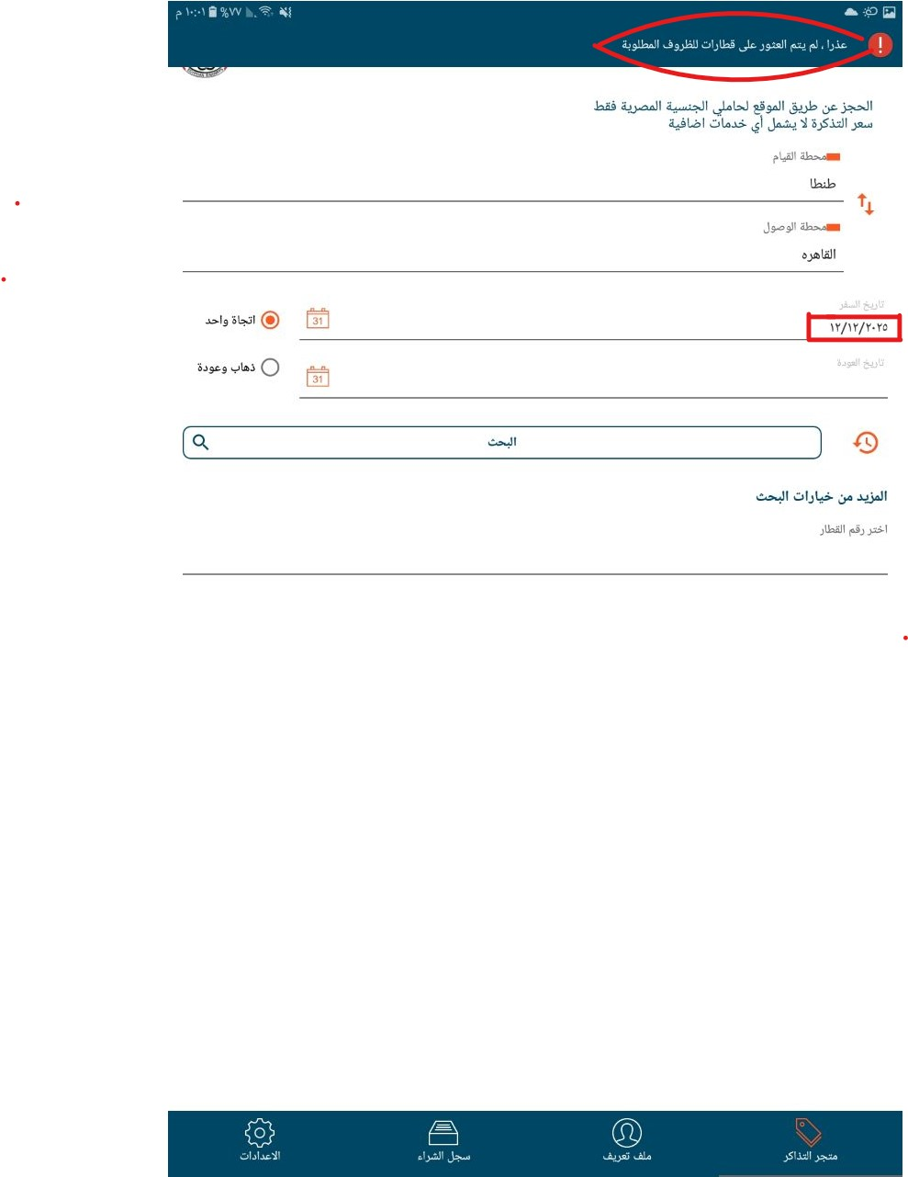
Date Selection Issue :
Users can select dates without knowing if trips are available.
Availability is shown only after submitting the search.
Error message appears after user action instead of preventing the error.
No visual distinction between available and unavailable dates.
Leads to repeated failed attempts and frustration.

Slide 4
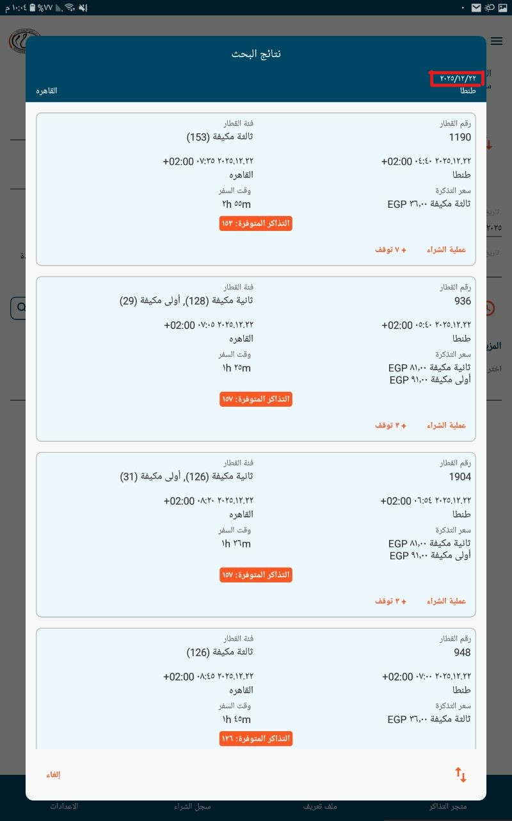
Trip Results & Schedule Visibility Issues:
Available trip schedules are hidden until after searching.
Users cannot immediately see available times for a selected date.
Lack of filtering or sorting options (price, time, duration).
Important information (price, duration) is not visually prioritized.

Slide 5
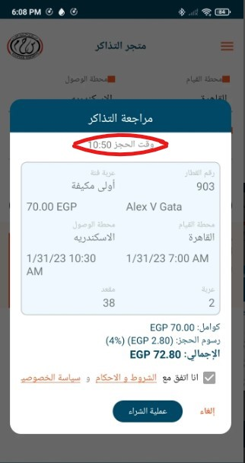
Payment Time Limit Issue :
Booking is limited to only 20 minutes without clear warning.
Countdown timer is not clearly visible.
No alerts or reminders before the time expires.
Booking expires suddenly with a generic error message.
Users lose their reservation after significant effort.
No option to extend booking time.
No way to recover or retry the booking after timeout.

Slide 6
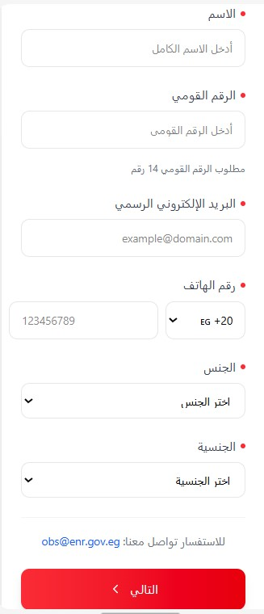
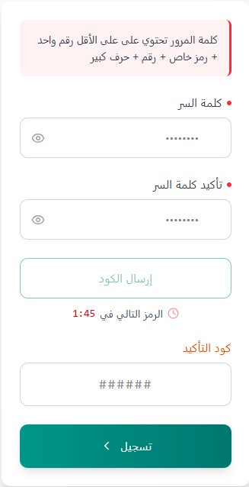
Login & Verification Improvements:
Added a clear page title to define the purpose of the screen.
Provided short instructional text to guide users.
Improved password field with clear requirements and guidance.
Highlighted primary action buttons to improve visibility.
Reduced unnecessary white space to improve layout efficiency.

Slide 7
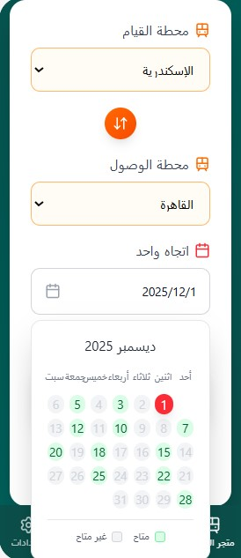
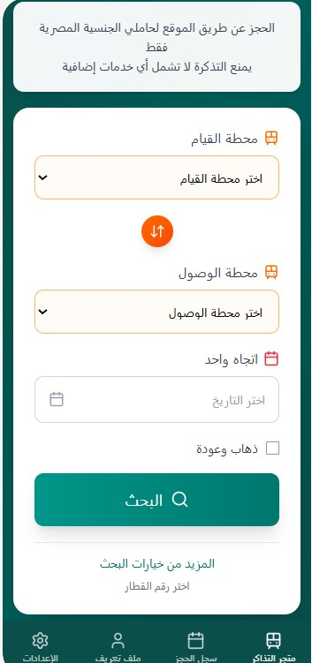
Date Selection Improvement :
Replaced the free date picker with a dropdown list of dates.
Clearly distinguished available and unavailable dates.
Disabled unavailable dates to prevent invalid selection.
Allowed users to select only dates with available trips.
Automatically displayed available trip schedules after selecting a valid date.
Eliminated unnecessary error messages related to unavailable dates.

Slide 8
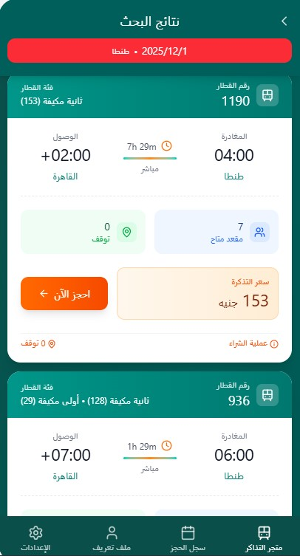
Trip Schedule Visibility Improvements:
Displayed available trip times immediately after date selection.
Reduced the need for blind searching.
Improved decision-making by showing schedules early.
Reduced the number of steps required to find a suitable trip.

Slide 9
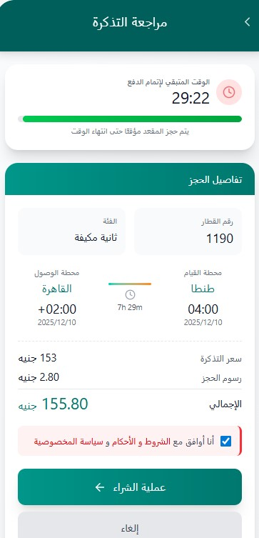
Payment Time Limit Improvements :
Clearly informed users about the 30-minute payment time limit before payment.
Added a visible countdown timer during the payment process.
Introduced visual progress indicators for remaining time.
Provided warning alerts when 10 and 5 minutes remain.
Added an option to extend the booking time once, if seats are available.
Improved timeout error messages with recovery options.
Allowed users to retry payment without restarting the entire booking process.
Temporarily saved incomplete bookings when possible.

Slide 10
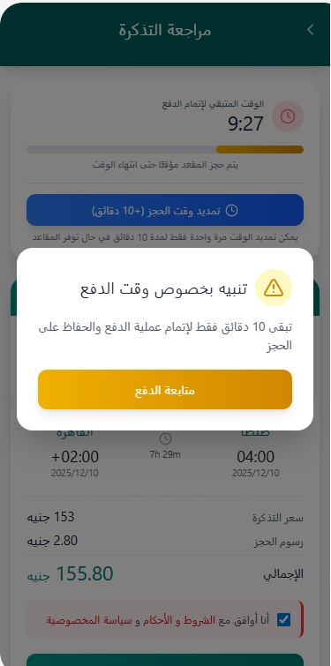
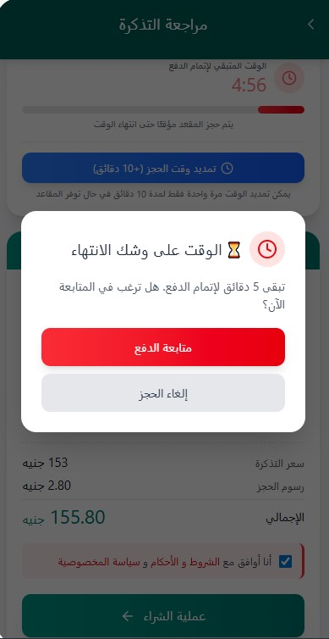
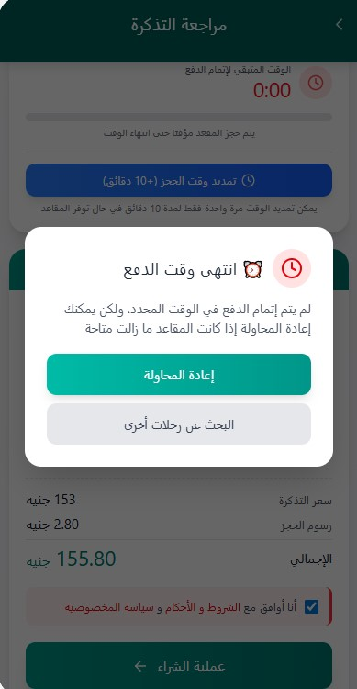

Slide 11
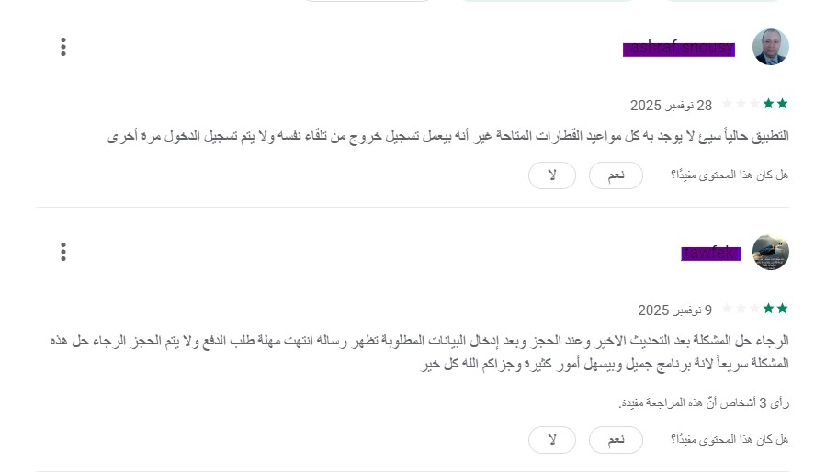

Slide 12
Thank You
Maryam Gomaa Dabash

